Slide 1
CSS
MCNDHS
Ms. Eng

Slide 2
AIM: WHAT ARE THE PROPERTIES OF CSS?
Do now:
Log into google classrooms
Open a tab and go to colorhex.com
Daily Grade:
On-time/attendance/not leaving the classroom: 25%
Cellphones: 25%
Notes:25%
Classwork/Homework: 25%

Slide 3
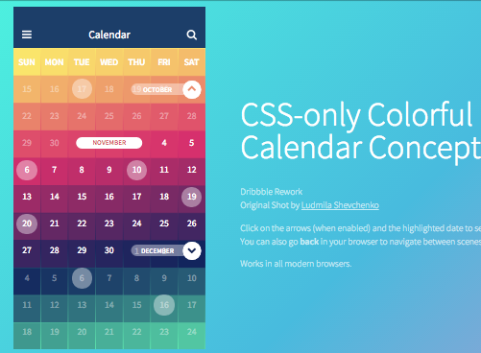
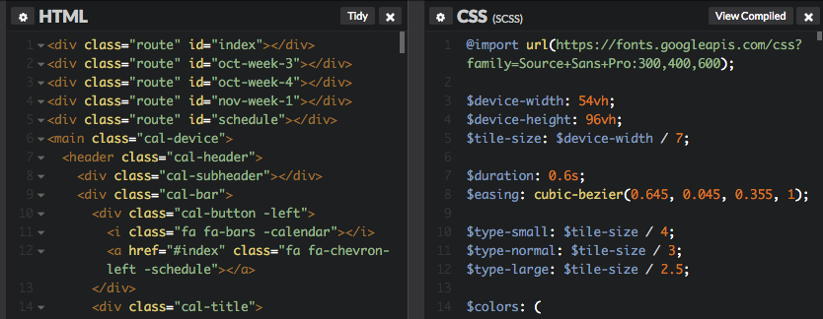
HOW DOES CSS WORK

Slide 4

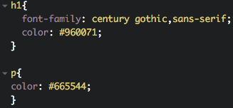

EXAMPLE:
Activity:
Write ten headings of different colors each.

Slide 5
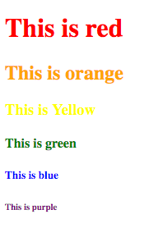
ACTIVITY:

